Slide 1
Science literacy: How to teach students the necessary skills
Dr. Carl J. Wenning
Physics Department
Illinois State University
Normal, IL U.S.A.

Slide 2
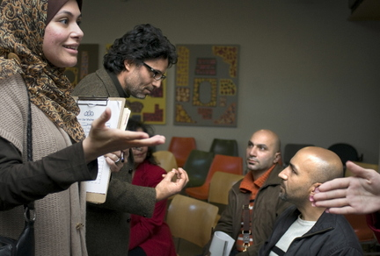
Science literacy: How to teach the necessary skills
Three critical questions:
1. What are the necessary skills of scientific literacy?
2. What is scientific literacy?
3. What is meant by the
words “to teach”?

Slide 3
What is meant by the phrase “to teach”?
Some operational definitions of teaching:
“Teaching is what teachers do.”
“Teaching is imparting knowledge or skill.”

Slide 4
Problems with one operational definition
Definitions of teaching that include such terms as imparting, knowledge, and skill are often ambiguous
imparting – informing? conditioning? training?
knowledge – knowing? believing? understanding?
skill – knowing that? (a bicycle is ridden this way) knowing how? (to ride a bicycle in actuality) knowing to? (ride a bicycle when necessary)

Slide 5
Descriptive definitions of teaching:
Teaching as Success
Teaching as Intentional Activity
Teaching as Normative Activity
Scientific Definition of Teaching

Slide 6
Teaching as success
“Teaching is that which results in learning.”
Problem: There are drawbacks with this form of definition:
Learning is the responsibility of the teacher!
Failure of students to learn is the fault of the teacher.
By this definition, an external observer cannot tell whether or not a teacher is actually teaching.

Slide 7
Teaching as intentional activity
“Teaching is undertaking certain tasks or activities the intention of which is to induce learning.”
Problem: A teacher can anticipate that certain activities will result in learning, but not guarantee it.

Slide 8
Teaching as normative activity
“Normative teaching requires that the activities of teaching conform to certain ethical standards.”
Problem: What type of normative activity?
conditioning (stimulus-obeying behavior)
indoctrinating (uniformed belief)
informing (information with explanations, no experience)
training (rule-obeying behavior)
instructing (informing and training)
teaching (uses processes of verification, shows concern for what students think, prepares students for independent acts)

Slide 9
A scientific definition of teaching
“Teaching is the process of carrying out those activities that experience has shown to be effective in getting students to learn.”
Problems:
a major problem is that there is very little research that agrees systematically on anything
craft wisdom is frequently good, but sometimes is in error
successful teaching cannot be reduced to a set of general rules, or a prescribed pattern of behavior.
A scientific definition is probably not possible given student autonomy

Slide 10
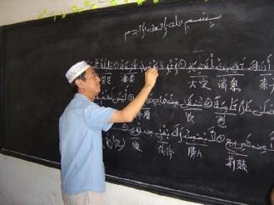
A working definition of teaching
“Teaching is the performance of certain ethical tasks or activities the intention of which is to promote learning.”

Slide 11
What is science literacy?
Types of science literacy:
cultural or nominal (students recognize terms)
functional (students use scientific/technical terms)
conceptual/procedural (students understand concepts and processes of science)
multidimensional (above plus students understand the nature of science, social context of science, differentiates science from other ways of knowing)

Slide 12
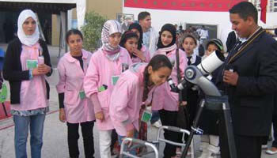
Common elements of science literacy
Knowledge:
facts
concepts
vocabulary
Skills:
manipulative
intellectual:
scientific reasoning
critical thinking
problem solving
Dispositions:
attitudes
behaviors

Slide 13
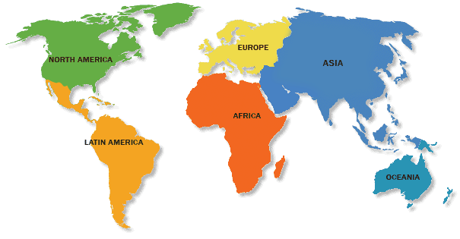
What is worth knowing?
personal needs
societal needs
global needs

Slide 14
How should one think?
Logically,
independently,
objectively,
skeptically,
critically,
and rationally
to reason scientifically and solve problems.

Slide 15
Behaviors and attitudes?
What type of future citizens do we want to prepare?
The five principles of Pancasila?

Slide 16
Levels of Inquiry Method
of science teaching will help teachers to systematically teach the knowledge, scientific and intellectual process skills, and dispositions characteristic of someone who is scientifically literate.

